Slide 1
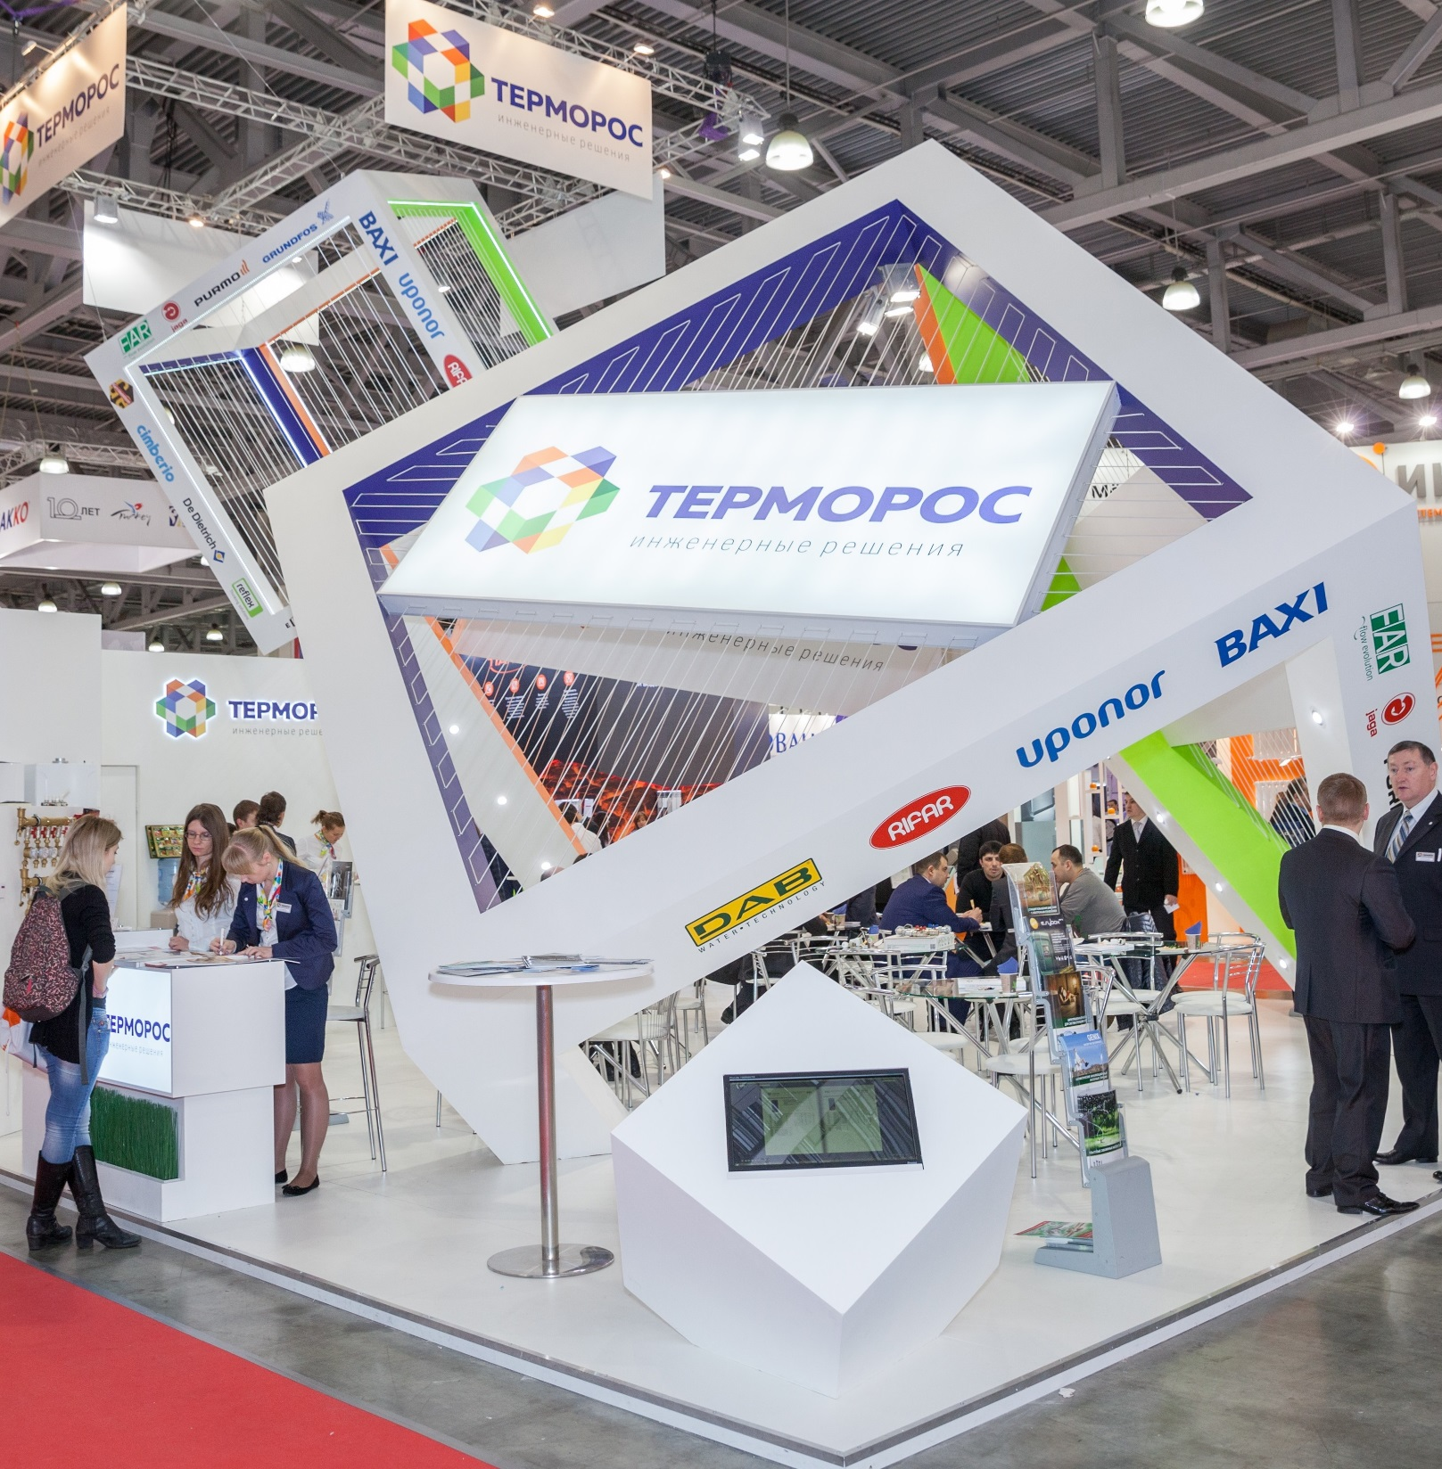
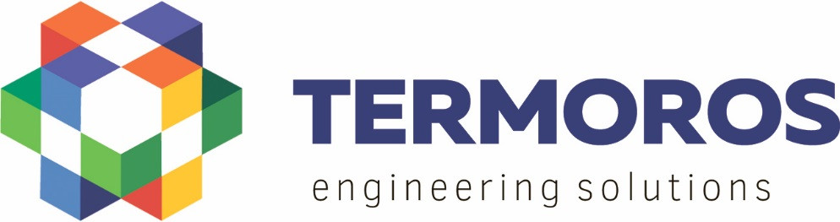
TERMOROS
Group of Companies
Moscow, 2018

Slide 2


The Termoros Group
More than 20 years of success in engineering systems for buildings and construction projects
More than 600 employees with highly professional skills
More than 50 brands in the product portfolio
Strong, exclusive brands
Proprietary Termoros brands
Leading brands of European manufacturers
More than 15 thousand SKUs in the product portfolio
More than 6 thousand loyal customers
Many years of experience in operating equipment on iconic objects in Russia and other countries

Slide 3
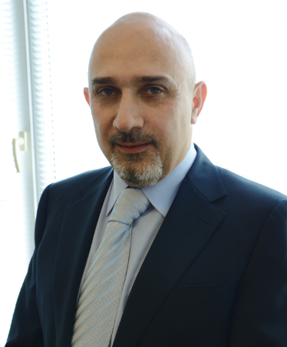
The Termoros Group
“We have deep professional knowledge and confidence in the quality of our products based on the extensive application of our equipment in a wide range of environments: from laboratory tests to installation and after-sales services.
The Termoros Group of Companies contributes towards the realization of energy efficient programs by implementing and promoting advanced technologies in the engineering systems of buildings and construction projects.
The modern and ecological engineering equipment offered by our company increases the aesthetic qualities and comfort of living space.”
Ashot Danielian
Termoros Group President

Slide 4
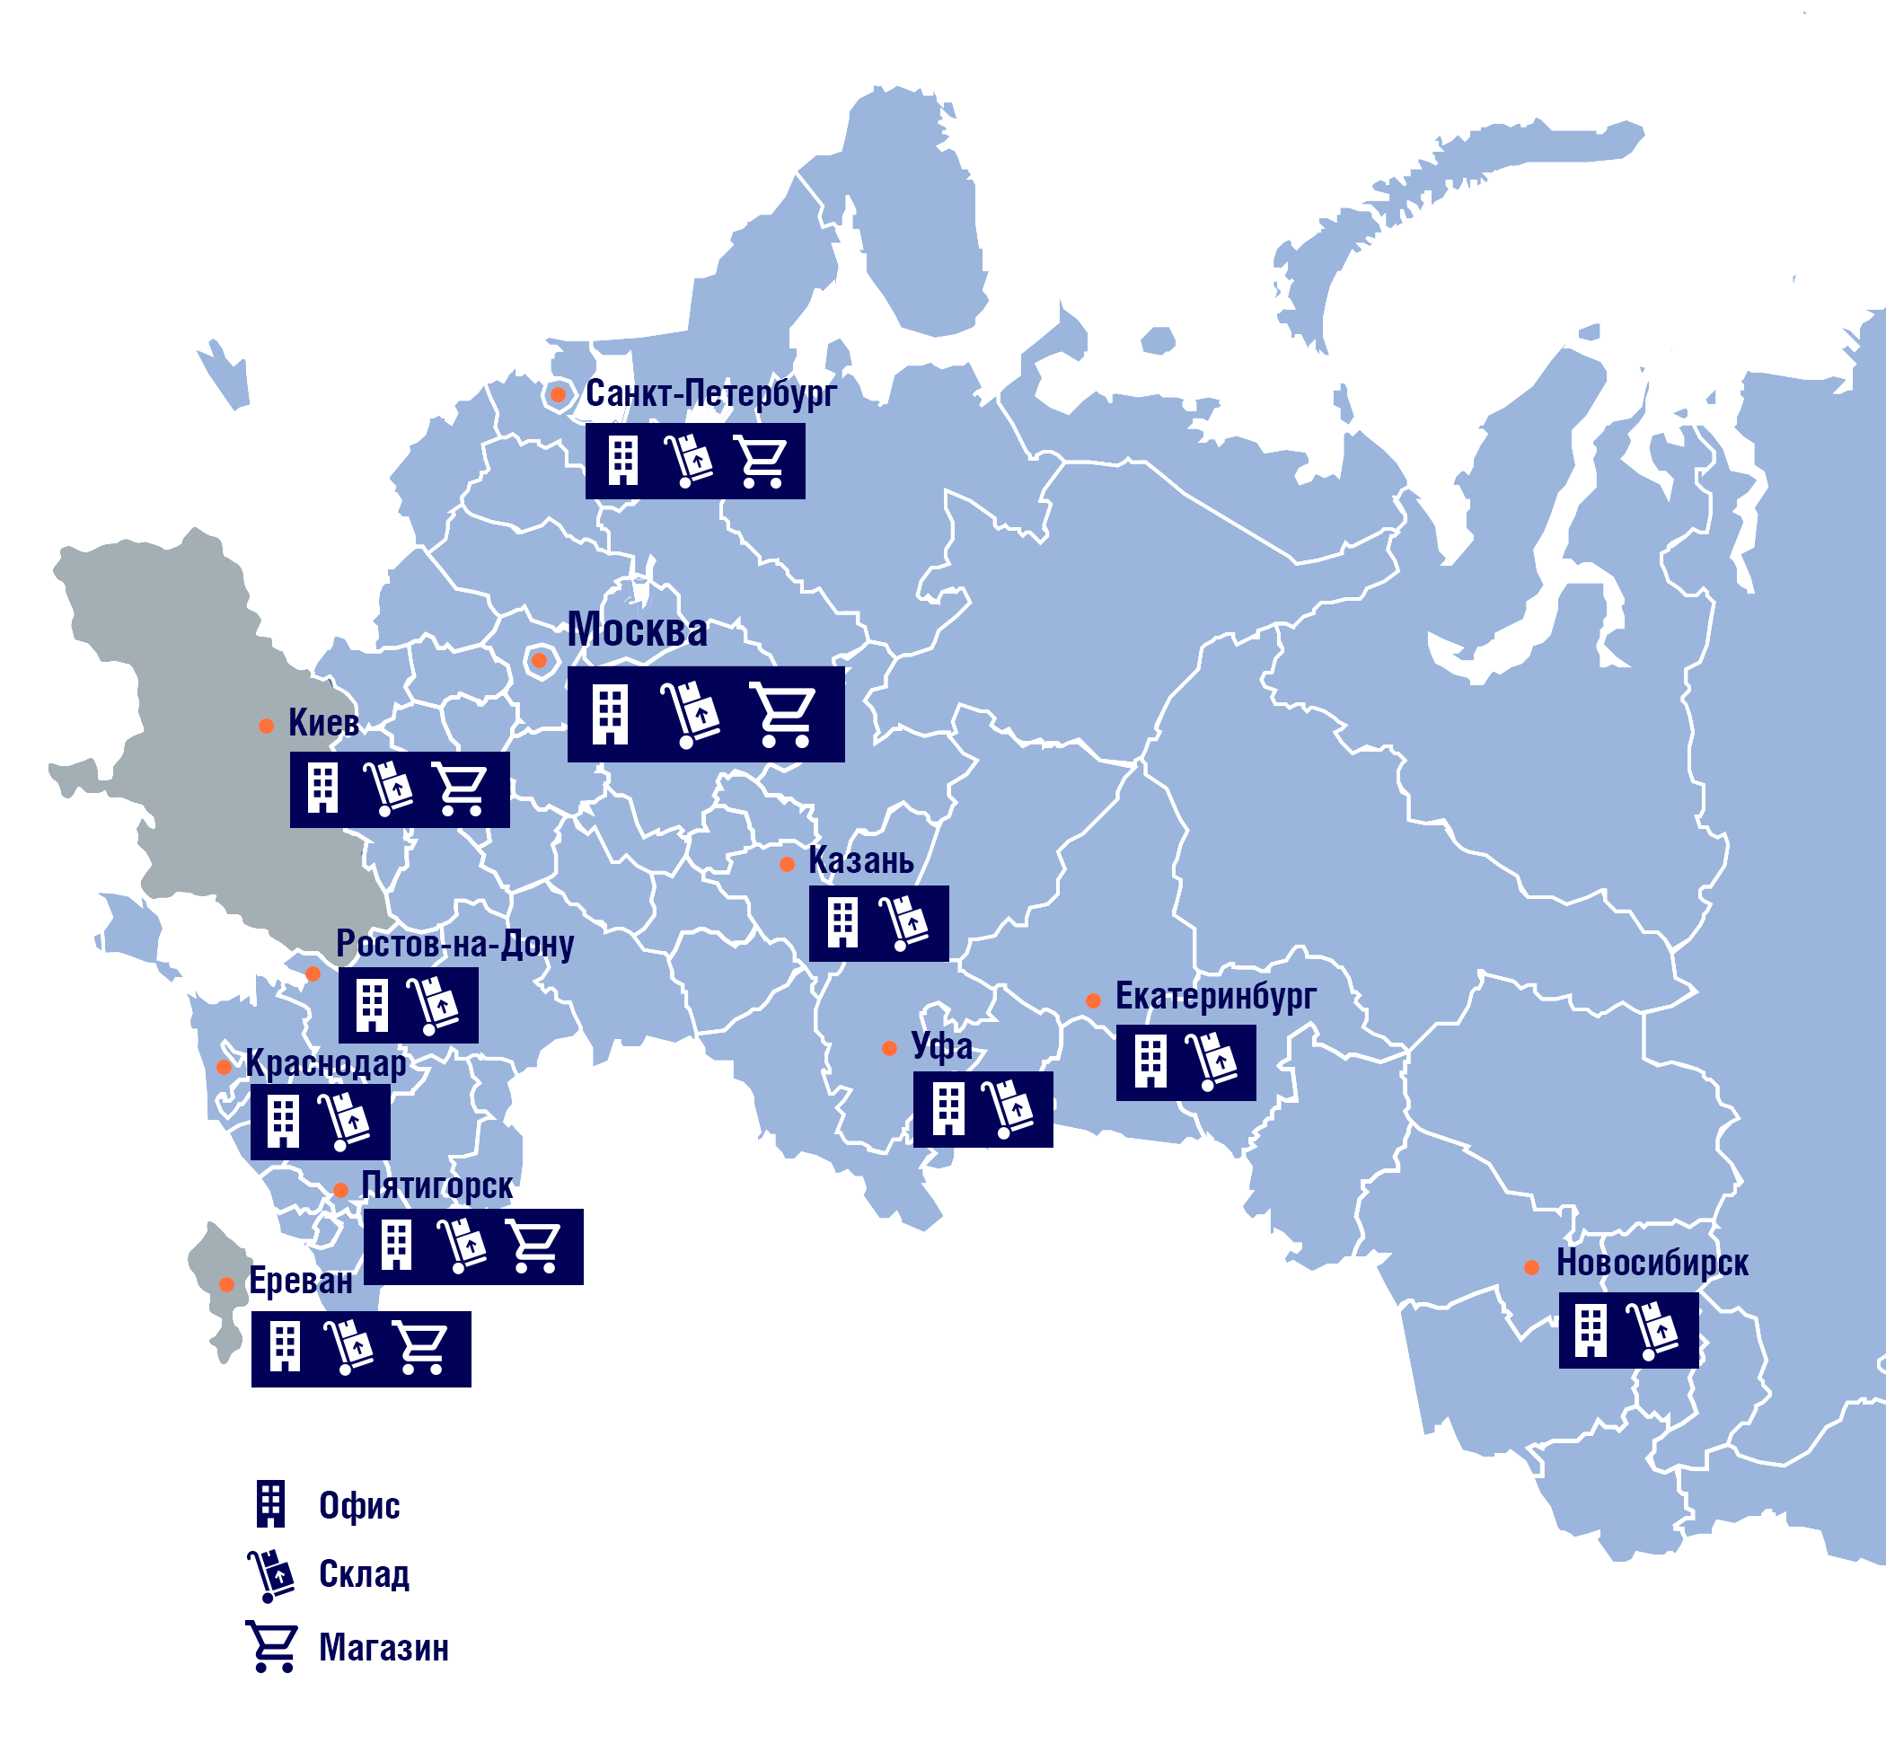
Termoros locations
Offices in 3 countries: Russia, Armenia and Ukraine
9 offices in Russia: Moscow, Saint Petersburg, Kazan, Krasnodar, Ekaterinburg, Ufa, Novosibirsk, Rostov-on-Don and Pyatigorsk
Warehouses in 11 cities: Moscow, Saint Petersburg, Kazan, Krasnodar, Ekaterinburg, Ufa, Novosibirsk, Rostov-on-Don, Pyatigorsk, Yerevan and Kiev
More than 400 service centers with spare parts warehouses in 220 cities of Russia
Company-owned retail stores in 5 cities: Moscow, Saint Petersburg, Pyatigorsk, Erevan and Kiev

Slide 5
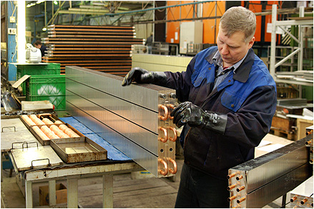
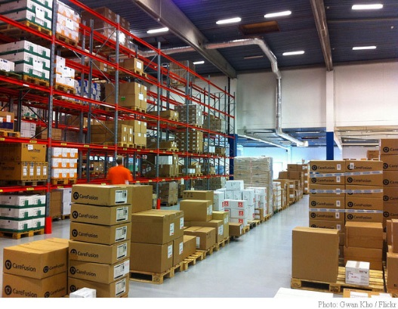
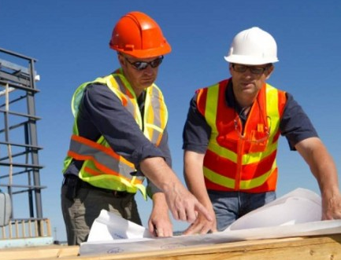
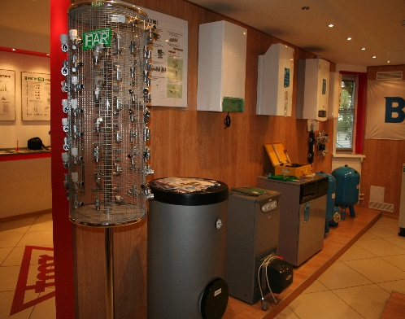
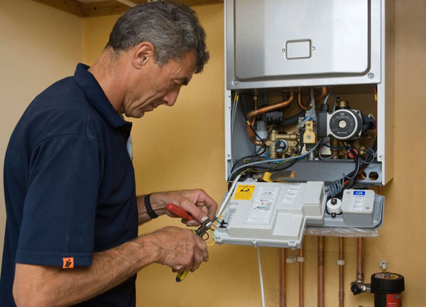
The Termoros Group
Production
Wholesale
Engineering
Retail stores
After-sales service support
Manufacturing in Russia
High-tech Gekon and JagaRus convectors
Convectors grids
Gekon collector’s junction’s with heat meters
TermoFAR heat floor junction’s
Wholesale of modern and high-tech engineering equipment from Russia, European and Asia producers.
Testing of all equipment is conducted in specialized laboratories on production sites as well as in Termoros laboratories.
Engineering projects from start to finish: from design to after-sales service.
Extensive experience working on iconic objects - from private houses to skyscrapers.
Company-owned retail stores in 3 Russian cities of Russia with a loyal customer base including distinguished designers and installation teams.
A range of professional and qualified consultants who have up to 15 years of experience
All types of after-sales service support. More than 30 engineers in the after-sales service department.
At the service centers, commitments are fulfilled within 24 hours.

Slide 6
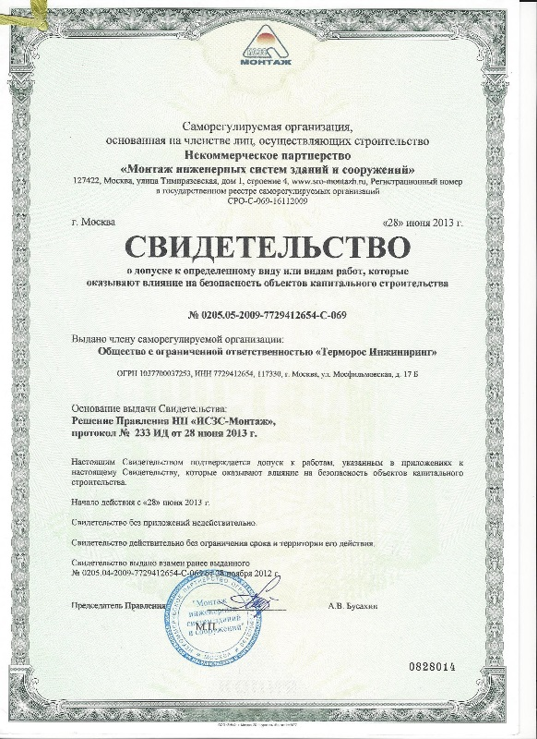
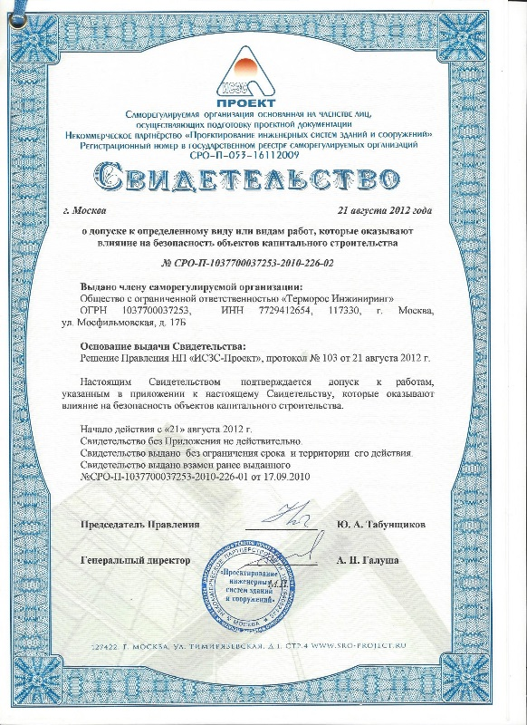
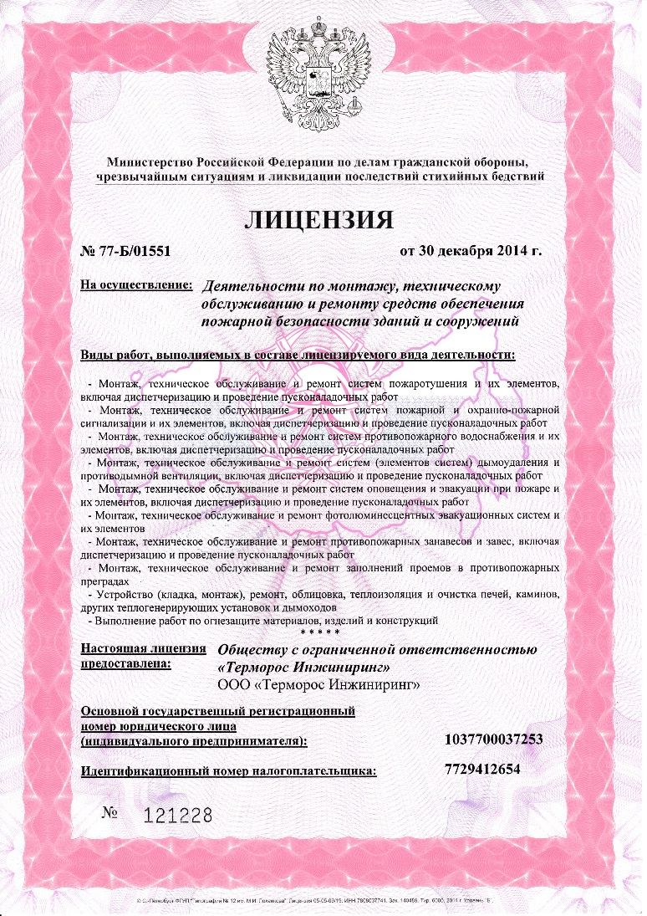
Certificates and permission documentation
All necessary licenses and permits for conducting design, construction and installation work as a subcontractor or technical supervisor, as well as for providing after-sales service support of installed equipment.
Our engineering equipment successfully passed tests in the Russian Research and Development Institute of Sanitary Engineering
Our products are certified by the Russian Federation State Committee for Standardization, and recommended for use in Russia.

Slide 7
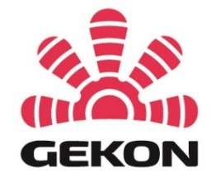



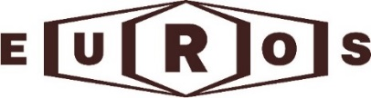



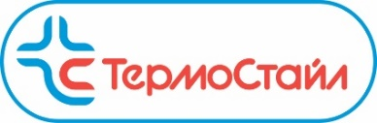
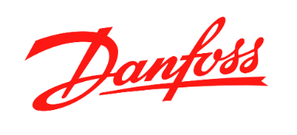

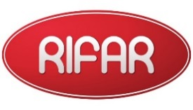

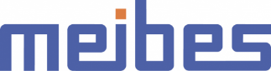

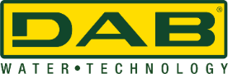

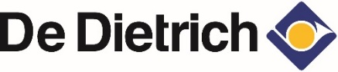


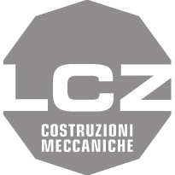







Brands we offer

Slide 8

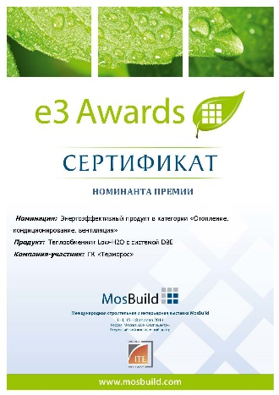
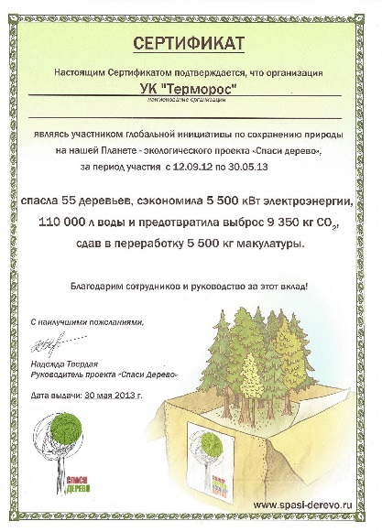
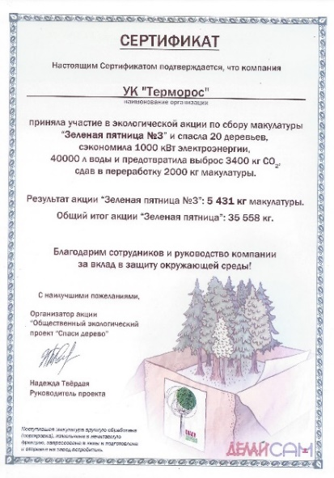
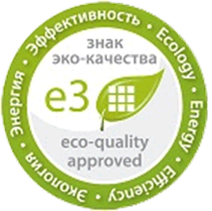
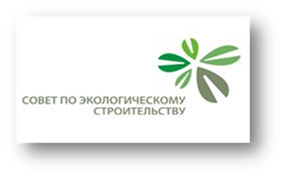
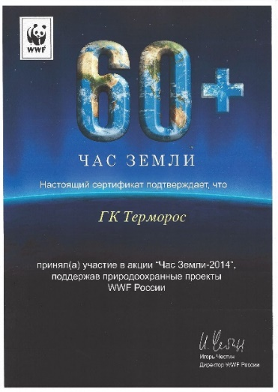

International awards received by our products for design, environmental friendliness and energy efficiency

Slide 9
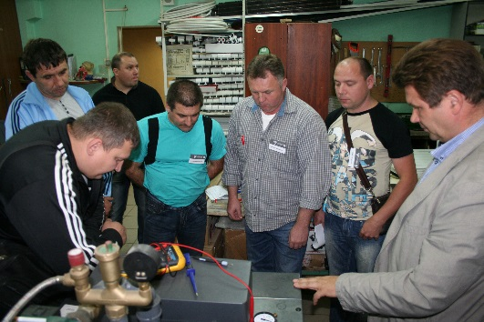
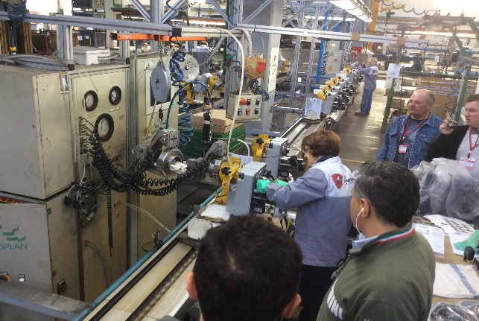
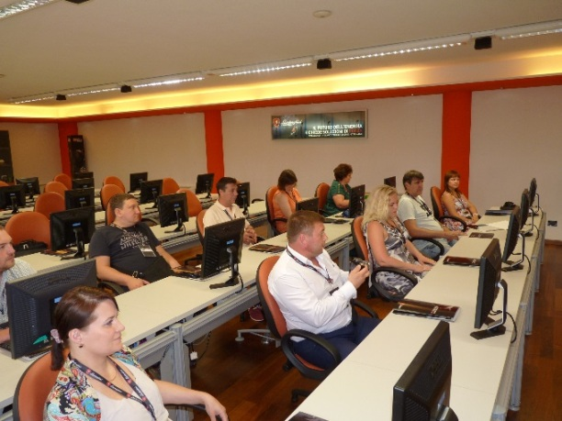
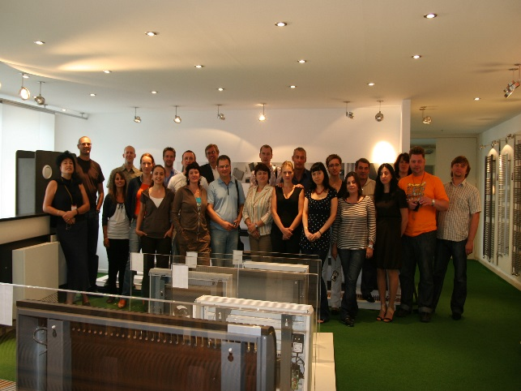
Education Opportunities for Termoros partners
We help our partners to develop technical and management skills.
More than 50 training events at production sites in Italy and Belgium were organized, which were attended by more than 1000 representatives of our partners.
Weekly technical training webinars for technicians of our partners.
Annual education conferences for our key partners.
Regular technical training seminars in Termoros offices and in the offices of our partners.
Sales trainings for key Termoros partners.

Slide 10
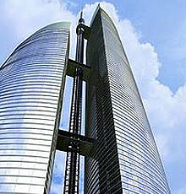
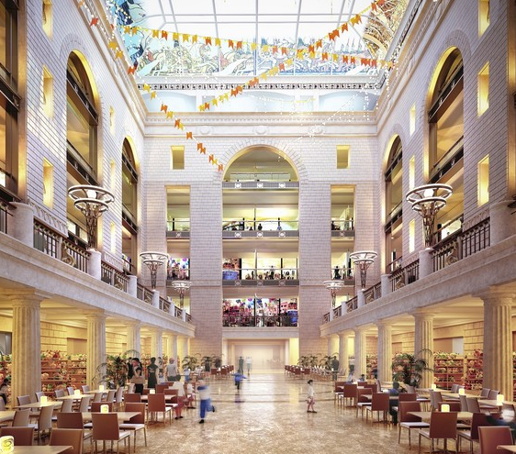
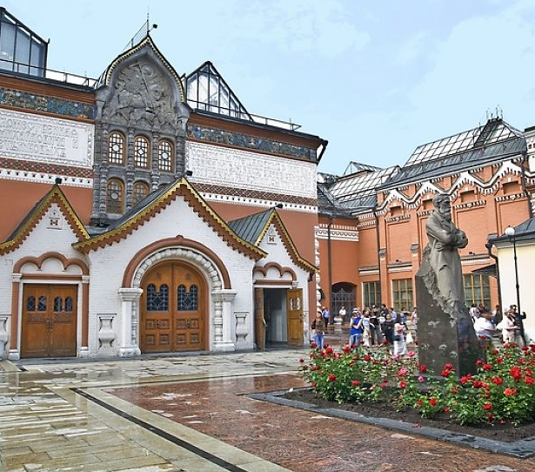
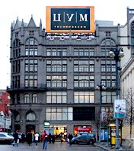
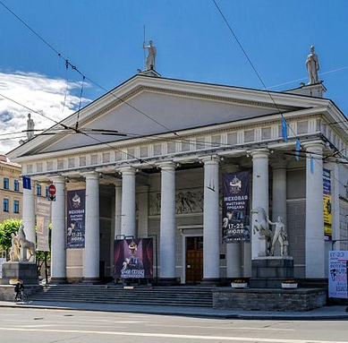
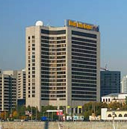
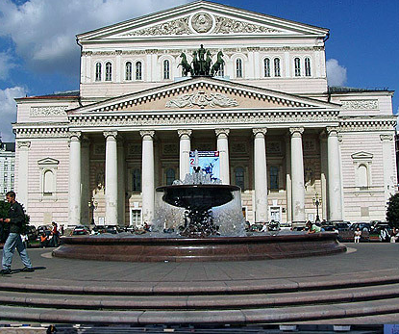
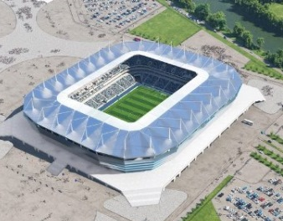
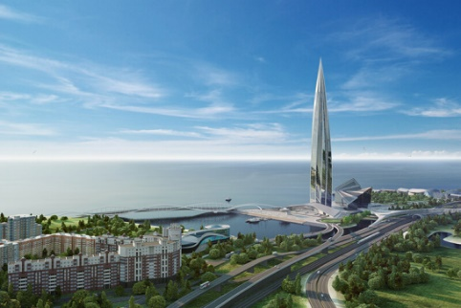
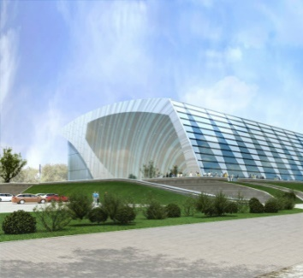
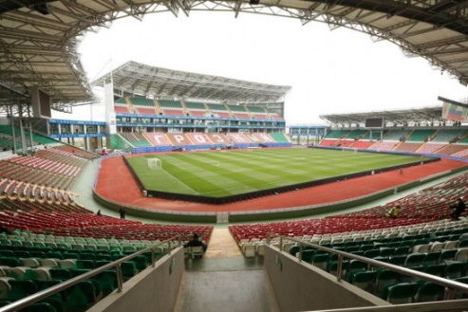
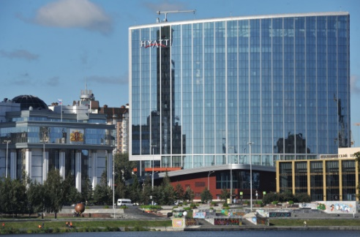
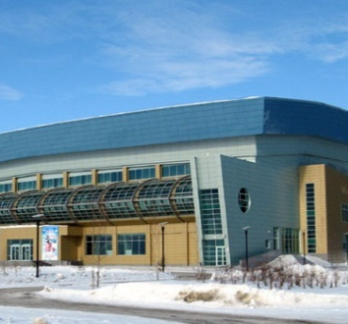
Over 10,000 construction projects using Termoros equipment
Moscow
Federation Tower
Moscow
Children's Paradise Central Department Store
Moscow
State Tretyakov
Gallery
Moscow
TsUM
Central Department Store
Moscow
Manezh Central Exhibition Hall
Moscow
World
Trade Center
Moscow
The Bolshoi Theatre
Kaliningrad
FIFA-Arena
Saint Petersburg
Lakhta Center
Kazan
Water Sports Palace
Grozny
Akhmat-Arena
Ekaterinburg
Hyatt Regency Hotel
Khanty-Mansiysk
Ice Arena

Slide 11
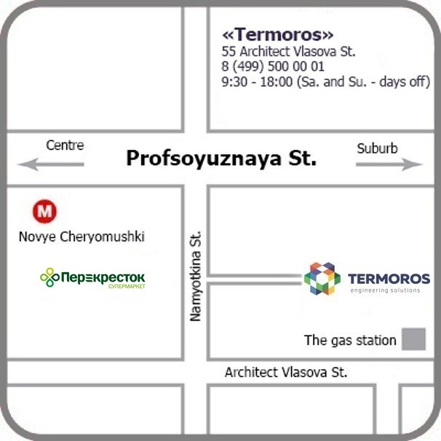
Offices in Russia
Head office
55 Architect Vlasova St., Moscow, Russia
Metro station: "Novye Cheryomushki“
+ 7 (499) 500-00-01
8 (800) 550-33-45
info@termoros.com
termoros.com
Saint Petersburg: +7 (812) 703-00-02
spb@termoros.com
termoros-spb.ru
Kazan: +7 (843) 567-19-91, 8 (800) 550-33-45
kazan@termoros.com
Krasnodar: +7 (861) 206-06-54
krasnodar@termoros.com
Ekaterinburg: +7 (343) 389-99-39
ekaterinburg@termoros.com
Ufa: +7 (347) 226-52-25
ufa@termoros.com
Novosibirsk: +7 (383) 328-00-86
novosibirsk@termoros.com
Rostov-on-Don: +7 (863) 203-77-60, 291-44-91
rostov@termoros.com
Pyatigorsk: +7 (8793) 38-93-96, 38-93-97
pyatigorsk@termoros.com

